Slide 1
The Latest Trends in Awqaf & Social Finance It doesn't get more trendy or by the people for the people than Waqf World Growth Foundation (WWGF)
AbdarRahman Chignell
Founder of WWGF

Slide 3
Why WWGF?
Complaints
Opportunity
Disrupting positively
Why the need for WWGF?

Slide 4
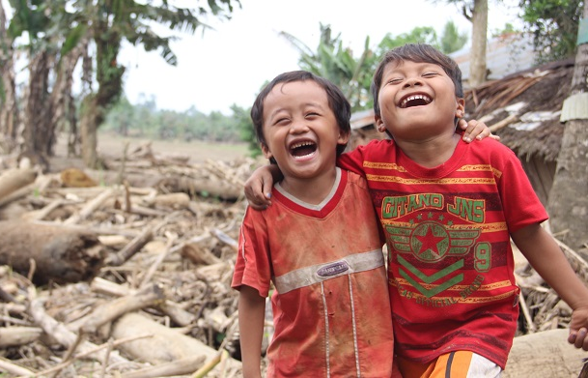
What is our Mission?
Preeminent Source
Objectives
Champion
Re-introduce
Freely

Slide 5
Backbone of WWGF
Cash Waqf
Fintech
Professionalism
Deen
Where the cash comes from?
Consultancy

Slide 6
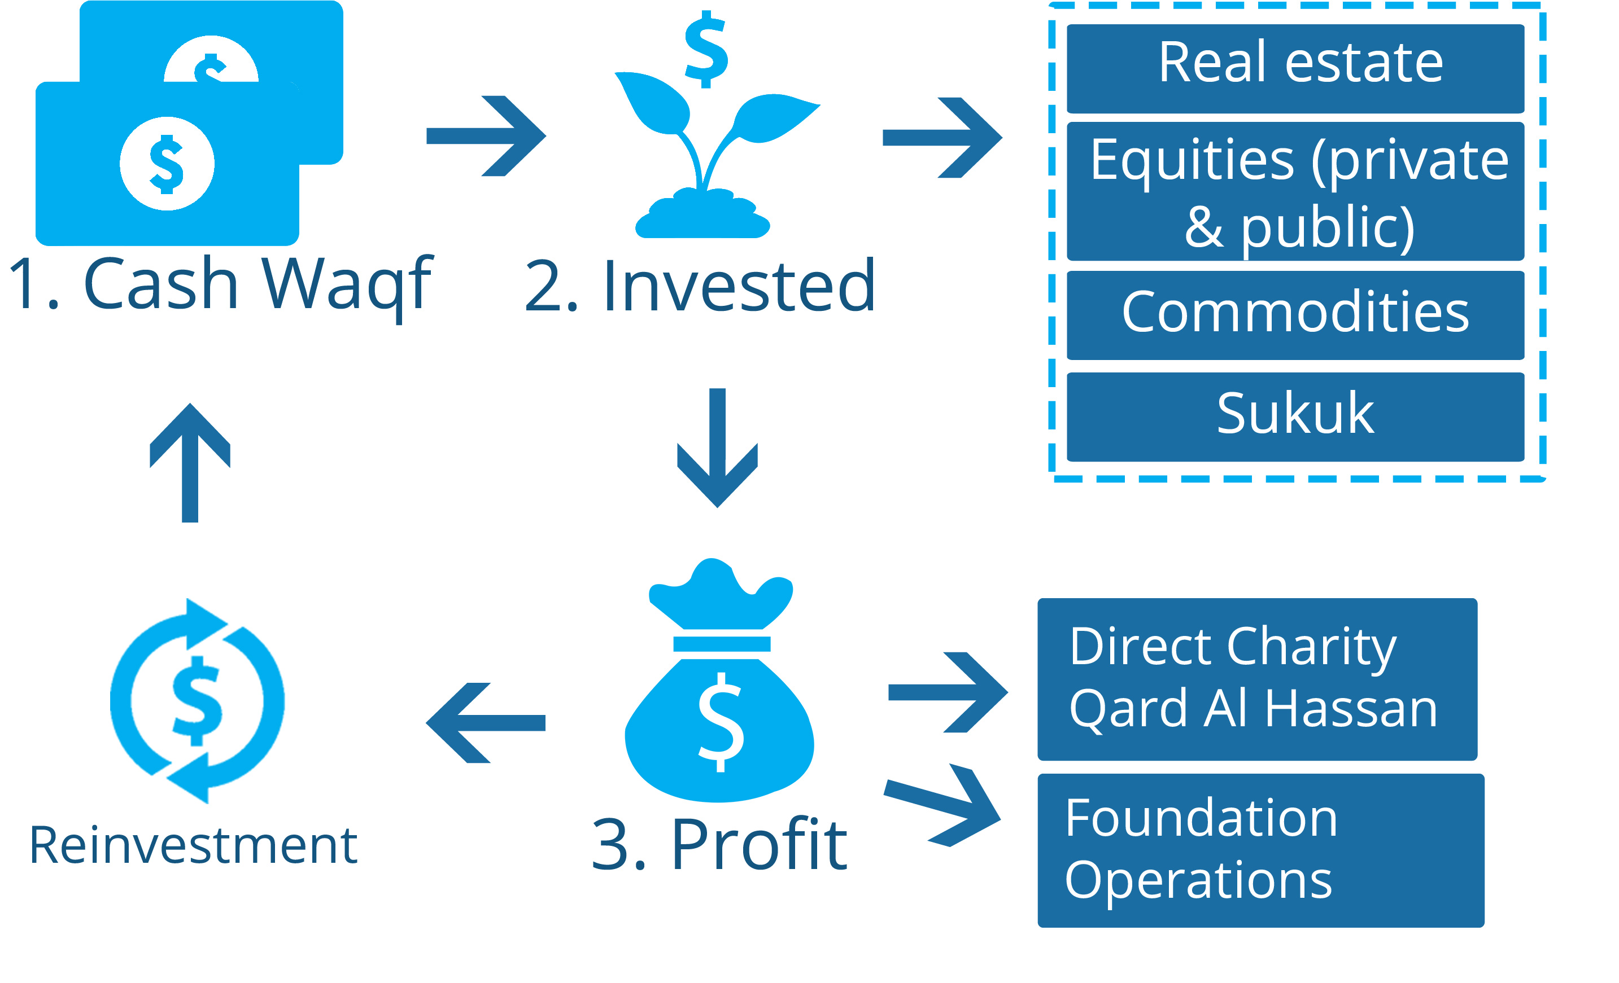
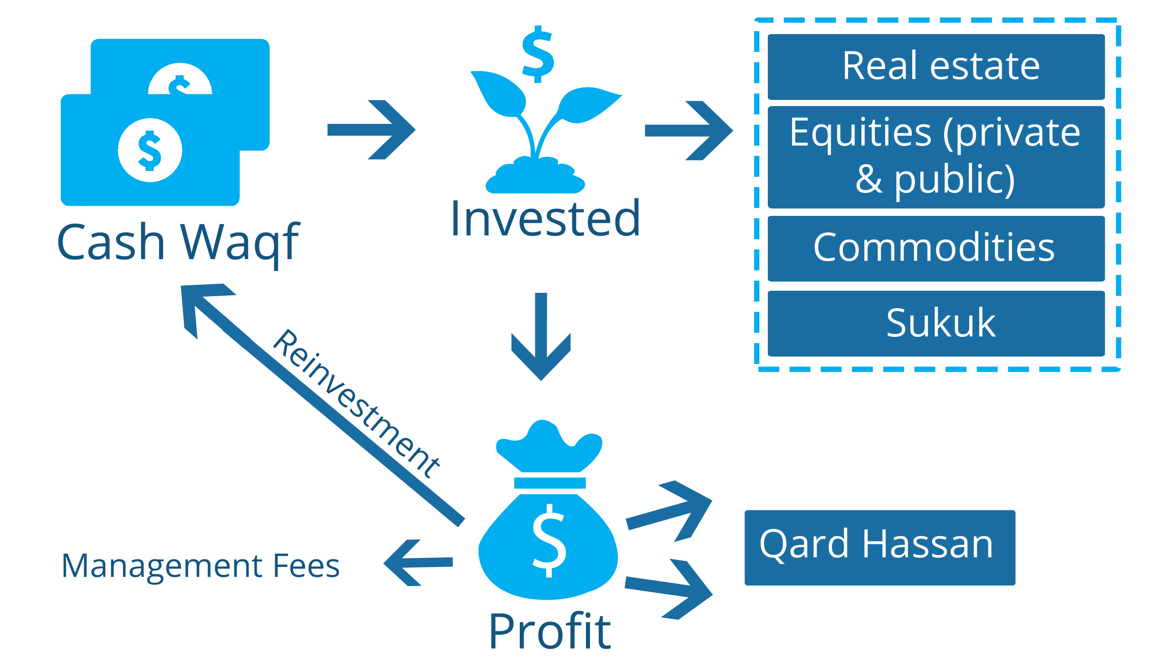
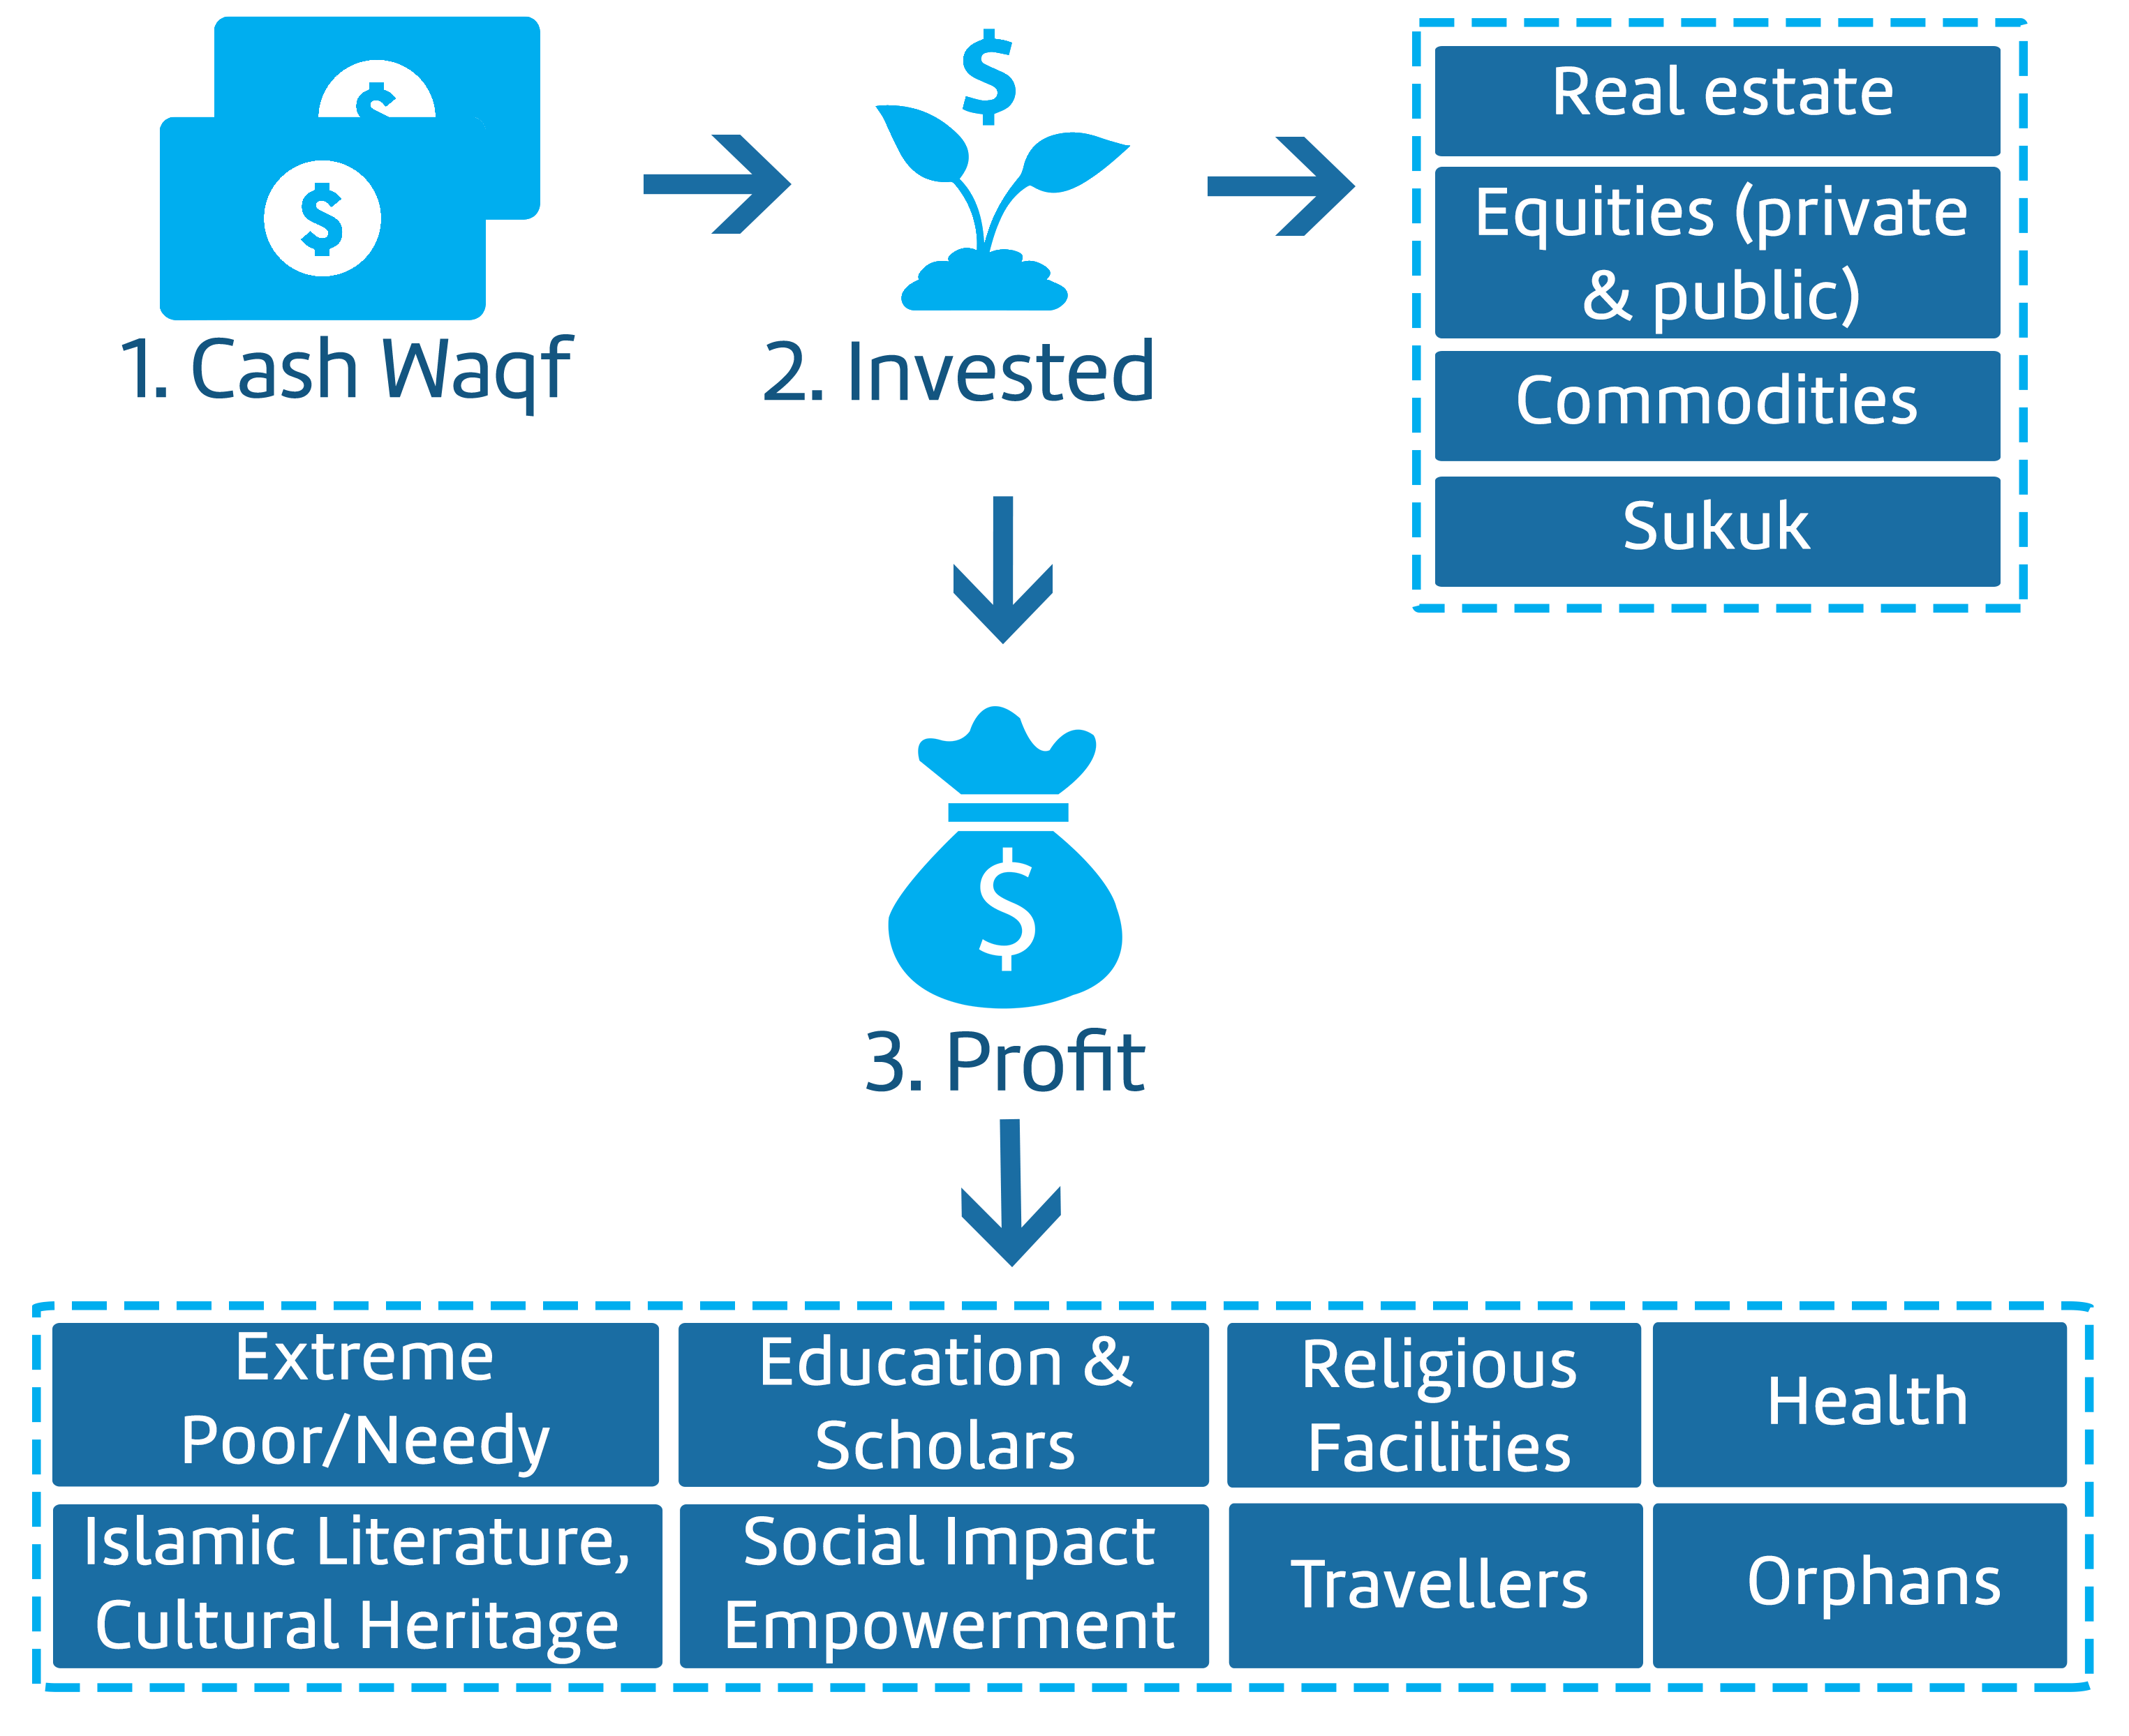
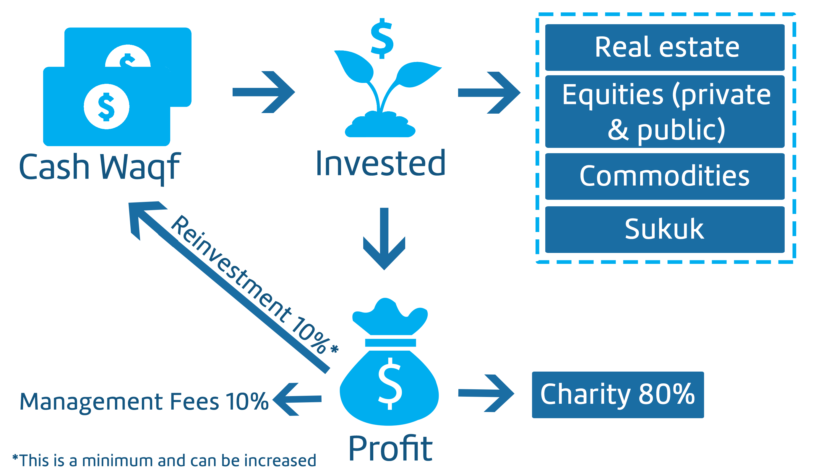
Key Models
Sustainability
Islamic Social Enterprise
Major Causes
Charity Causes

Slide 7
WWGF Having an Impact
World Tour
Build better conditions
How is WWGF making a difference?

Slide 8
Charity Causes World Tour

Slide 9
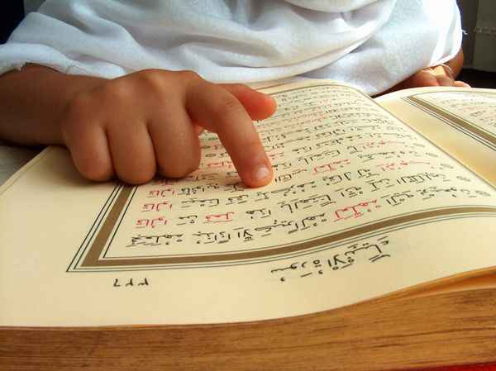
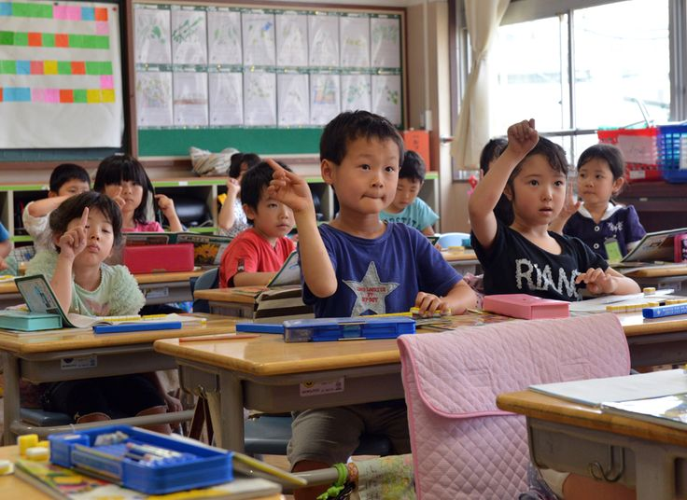
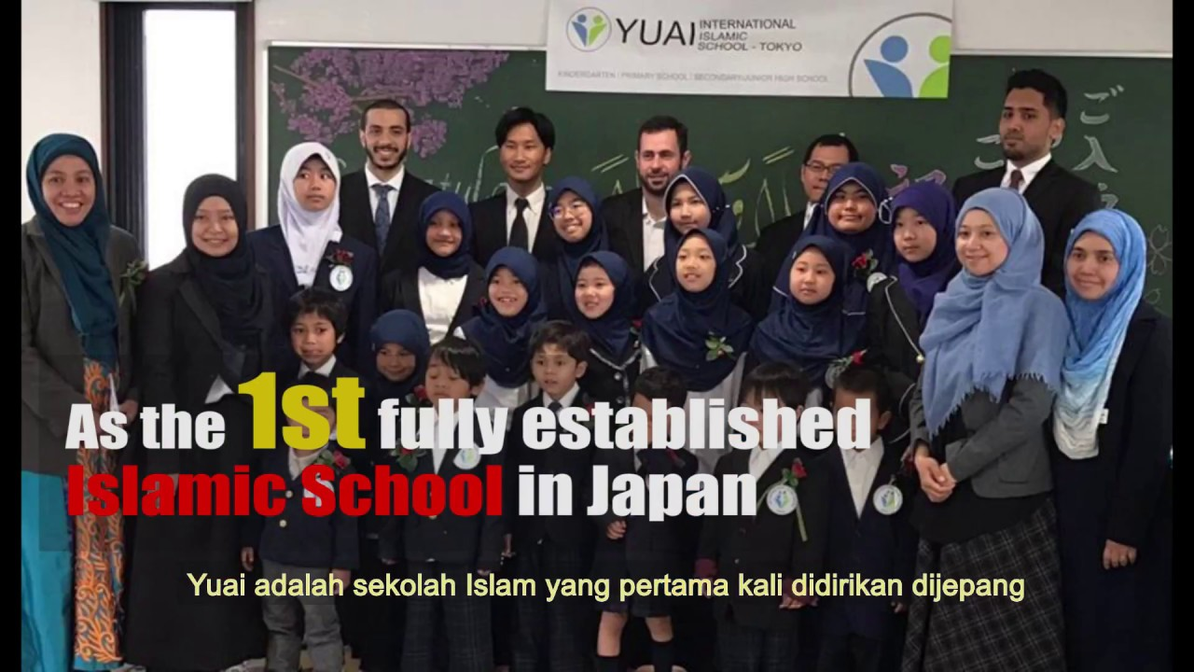
Japan – YUAI International Islamic School
Address future educational needs for Muslim minorities in Japan
Salary for Quran teachers
After-school programs
Scholarship fund

Slide 10
New Zealand – Trade Not Riba
Educate the ummah regarding the seriousness of engaging in riba
Tailored training programs
Topics include:
Islamic social entrepreneurship
Islamic and alternative finance
Waqf (endowment) investment
Micro-finance
Non-profit investment
Investment management strategies

Slide 11
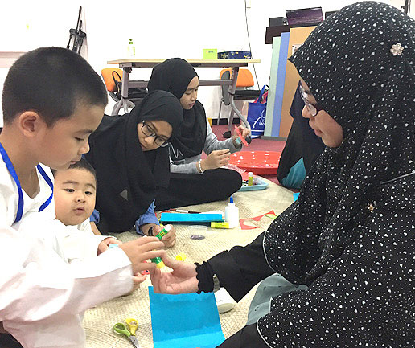
Brunei – Tarbiyah Project
Islamic driven enrichment programme using a ‘play-and-pray’ game approach
Based on Al-Quran and Hadiths
Principals of Tawhid and model Islamic behaviour
Classes for young Muslim entrepreneurs

Slide 12
Malaysia – Khalifah Institute
7 years of success in educating students to become Muslims of excellent character
The Khalifa method: traditional knowledge and practices of Islamic educational methods combined with Modern Islamic Psychology
Established primary school; adding a secondary school
Training facility for teachers to apply the methodology

Slide 13
Bahrain – Something Big Coming Soon!

Slide 14
Kyrgyzstan/Somaliland – Social Enterprise
Opportunity to develop communities at a grassroots level
Empower Muslim women through training & skill development
Support the development of Islamic social enterprises

Slide 15
Germany – Islamic Manuscript Association
Millions of manuscripts around the world, surviving centuries of political, social and economic change, need to be saved, catalogued, and made accessible for research and education
Resources and materials for proper preservation and documentation
Free online manuscript catalogue hosting service in Arabic and English

Slide 16
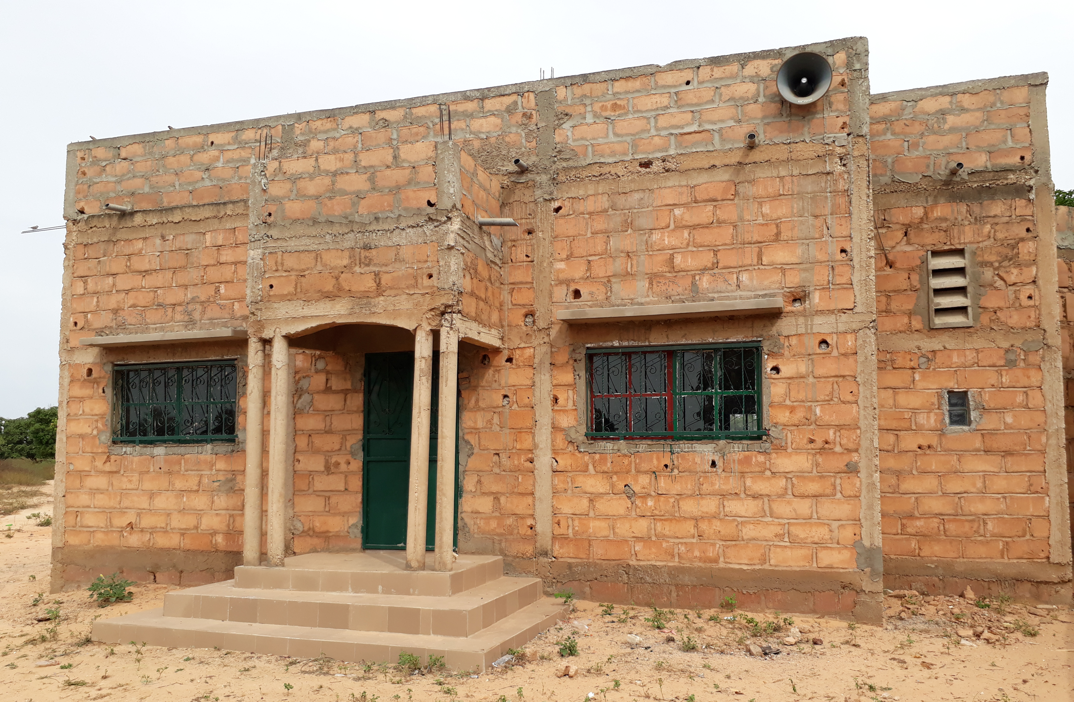
Senegal – Quran School Project
Current lack of infrastructure and education for young Muslims
80 students currently being taught in a poor area
Increase enrolment and diversification of education program
Egg production and installation of solar panels
Aquaponic farming

Slide 17
Ghana – Something Big Coming Soon!

Slide 18
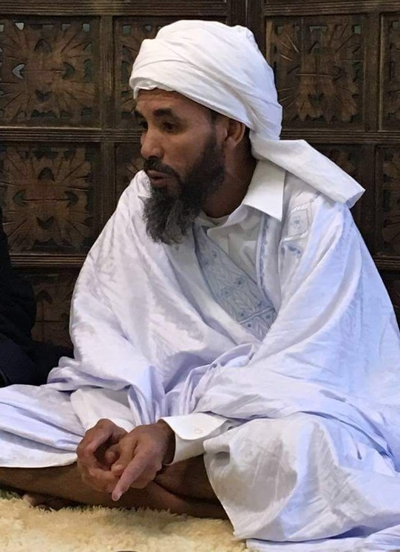
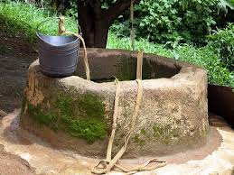
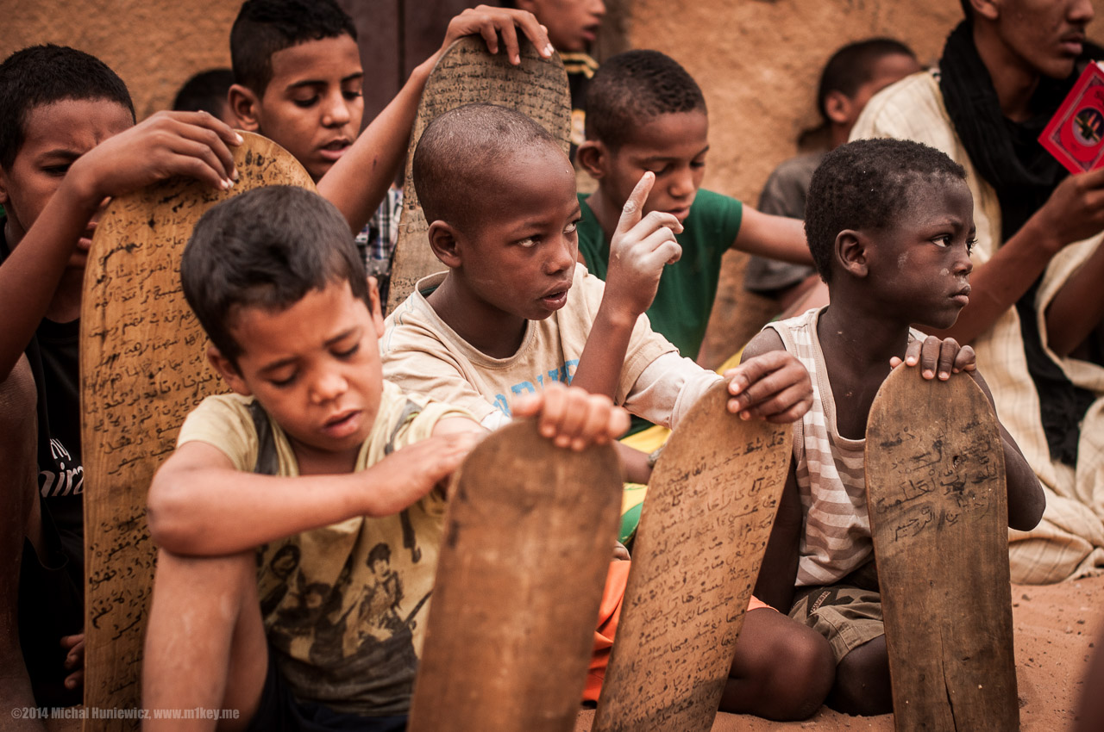
Mauritania– Schools & Wells
Establish Islamic schools that preserve knowledge while respecting the local culture and teaching methodologies
Build wells to support the community
Shaykh Salek from Mauritania, West Africa, a country known for producing some of the Muslim world’s most knowledgeable scholars. He studied for over 17 years, from numerous accomplished scholars including Murabit al-Hajj, one of the greatest scholars of our age.

Slide 19
Spain – Grand Mosque Granada
Cash Waqf to support to the Grand Mosque and it’s programs
Support for physical Awqaf development
Management of Awqaf properties

Slide 20
UK – Educational Partnerships
Support educational programs that allow local Ulema to upgrade their accreditation and integrate into their community
Social empowerment and development to give people in struggling situations a better life for themselves and their families

Slide 21
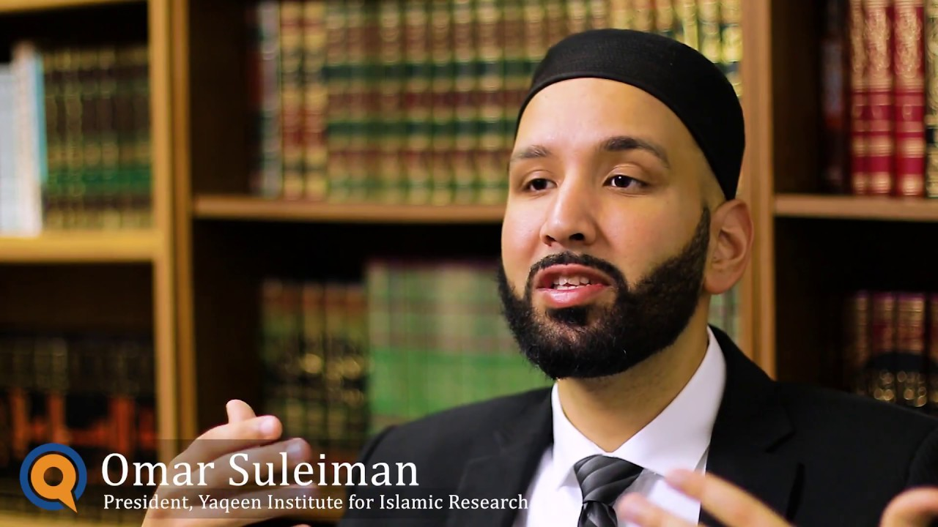
United States – Tayba, Bayyinah & Yaqeen!
Tayba Foundation – the forgotten believers
Bayinnah – scholarship support
Yaqeen – Islamic research and education

Slide 22
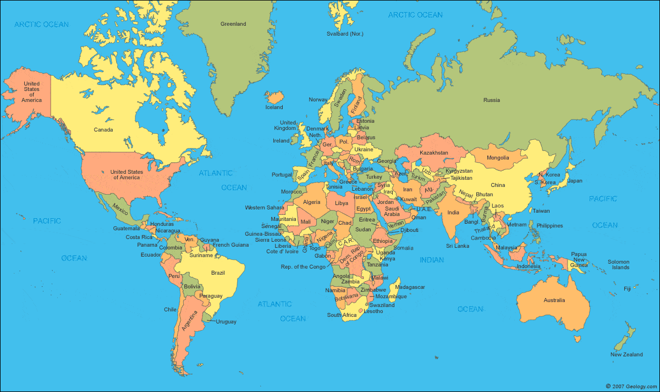

Slide 23
"Perpetual - Irrevocable - Inalienable and Reviving the Sunnah"

